Slide 1


ADVANCED SOIL moisture monitoring system
~ Krishna dugad (40) – L2
Harsh Nevse (53) – L3

Slide 2


Idea behind the project
Planting a tree in an environment where the seed or the plant would not get water adequately through natural sources like rain or groundwater in its initial phases has always been a matter of concern for tree planters, Especially visually and audibly impaired planters. This is where an autonomous moisture monitor for plants system can help.

Slide 3
Working of the system
The system timely monitors the moisture level of the soil. If at the time of monitoring it comes to know that the moisture level of the soil is increasing, it will raise a visual alert as well as an audio alert. This alert is then received by the caretaker of the plant.
As long as the alert is on, the impaired caretaker will know that the plant is not in short of water. When the alert turns off, it suggests that the soil is out of moisture and water is required.
A moisture level sensor is used to detect the moisture level of the soil. An LED is used to give visual alarm and a buzzer is used to give audio signal to the caretaker of the plant.
Thus, in this project with the help of a simple combinational circuit and a sensor we can help save a plant by maintaining the moisture level of the soil of the plant, thus keeping the plant healthy and help impaired planters and farmers.

Slide 4

PROJECT Materials
Resistor – 680ohms
Transistor – BC 547
Cables and Connectors
Buzzer
LED -RED
Breadboard
Battery – 9V

Slide 5

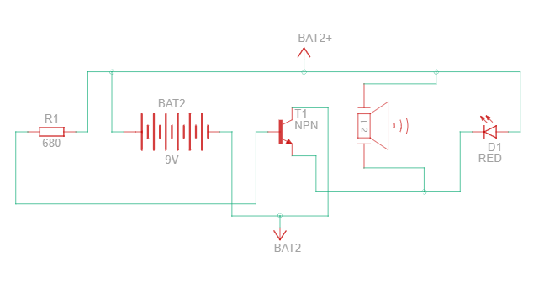
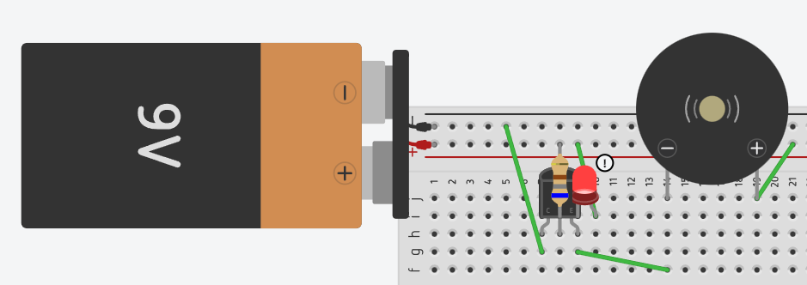
process
CIRCUIT DIAGRAM
SCHEMATIC REPRESENTATION

Slide 6
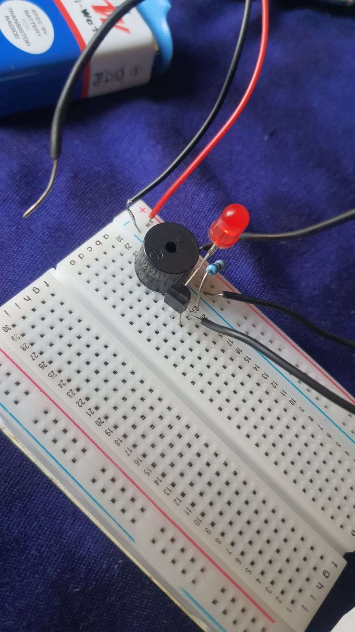
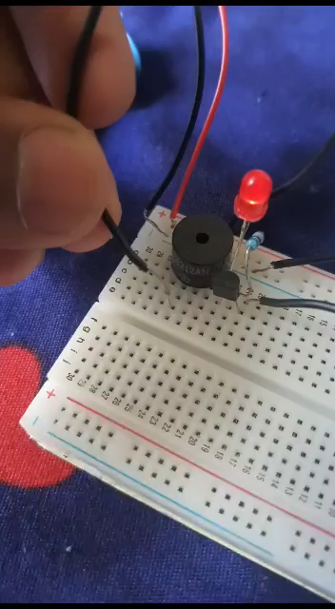
Circuit with dry soil
Circuit with wet soil
Circuit is grounded with the two wires coming out the emitter and base of the transistor.
LED and buzzer don’t work in this case.
Here some water was added only to one corner of soil. Buzzer doesn’t start at full intensity.
When considerable moisture level is reached, Buzzer works at full potential.

Slide 7

Sources
GOOGLE
YOUTUBE
300 ELECTRONIC PROJECT
A BEGINNERS GUIDE TO CIRCUITS

Slide 8
✩✩✩✩✩✩✩✩✩✩✩✩✩✩
THANK-YOU

